Slide 1


Airline Delay Classification
Gianni Conde
Kelsey Kirby
Mark Stiles
IST 718 - Big Data Analytics
June 2024

Slide 2

Dataset
This is a combination of the original airline delay data with the airport latitude and longitude information. We also used a lookup table for converting airline codes to airline names.
Data Shape:
539,382 observations
8 variables
Sources:
https://www.kaggle.com/datasets/ulrikthygepedersen/airlines-delay
https://www.kaggle.com/datasets/aravindram11/list-of-us-airports

Slide 3
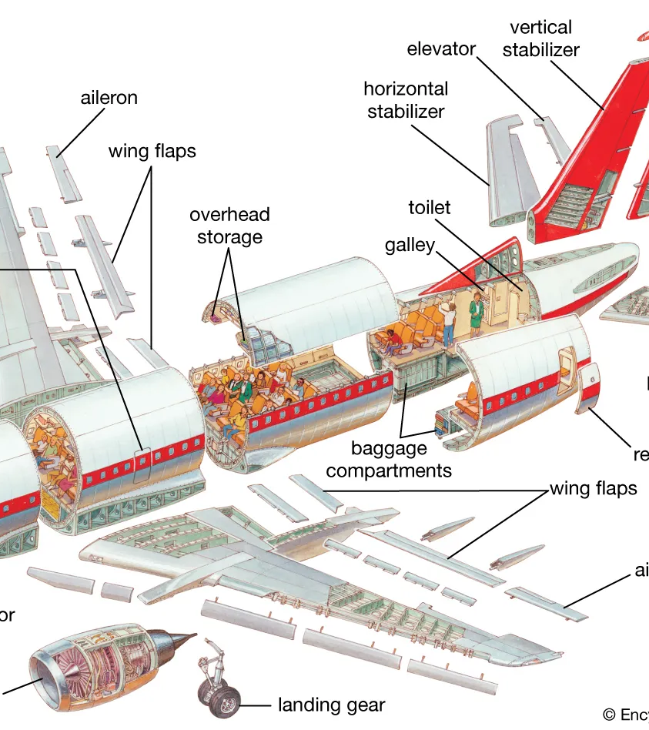
Feature Engineering
Airline
Day
Time of Day
Departure / Arrival Time
Departure / Arrival Location
Flight Duration

Slide 4
Schema
Renamed to more intuitive labels and discretized some variables.
Flight
DepartureMin
FlightMin
Airline
DepartureCode
ArrivalCode
DayOfWeek
Class
ArrivalMin
Day
TimeOfDay
DepartureTime
ArrivalTime
FlightDuration
DepartureAirport
DepartureState
DepartureLatitude
DepartureLongitude
ArrivalAirport
ArrivalState
ArrivalLatitude
ArrivalLongitude
538,066 observations
22 variables
Flight
Time
Length
Airline
AirportFrom
AirportTo
DayOfWeek
Class

Slide 5
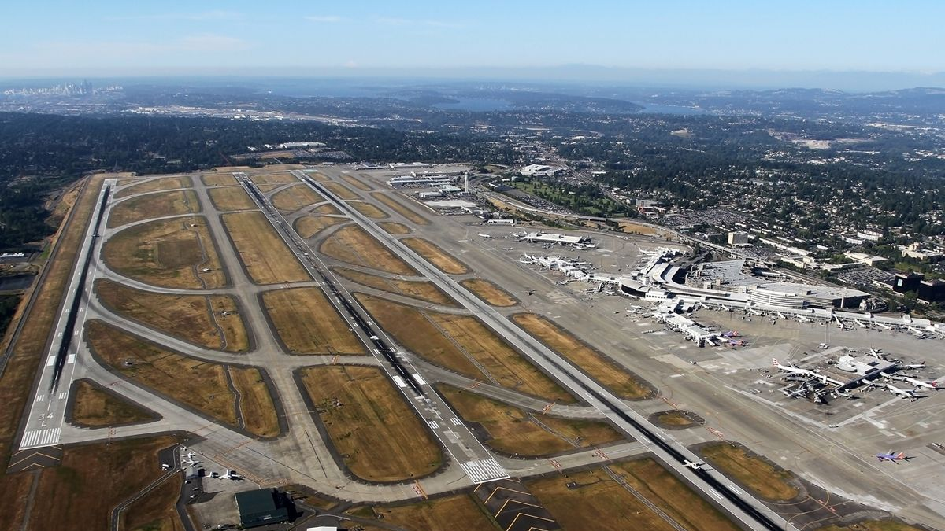
Exploratory Data Analysis

Slide 6
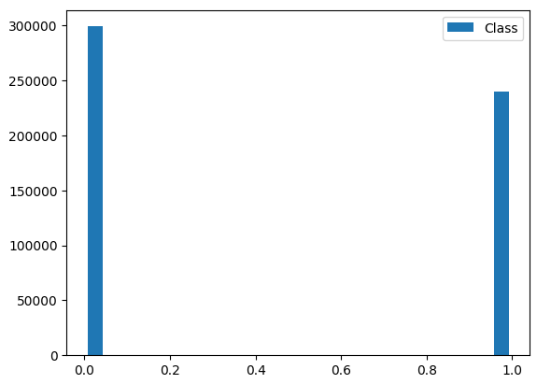
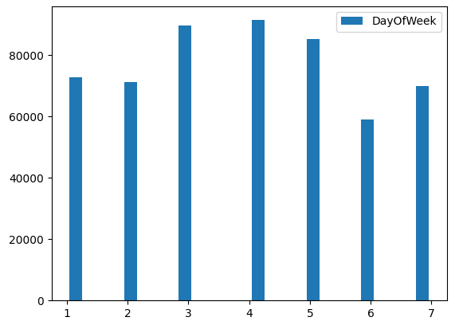
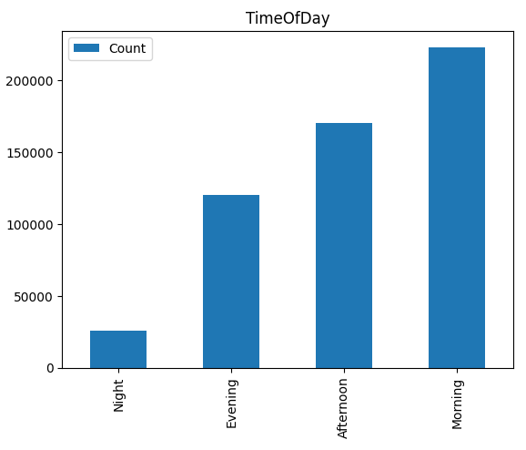
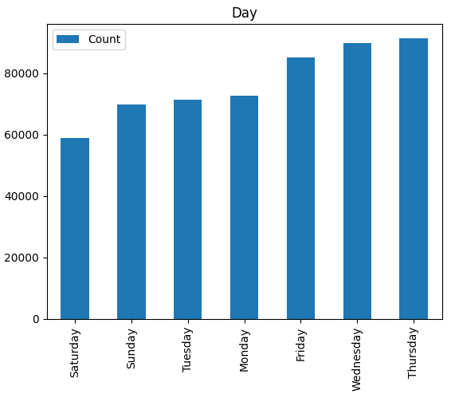
Analysis

Slide 7
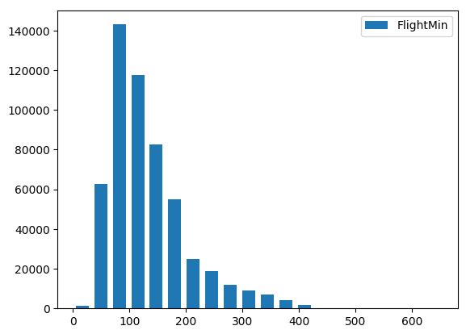
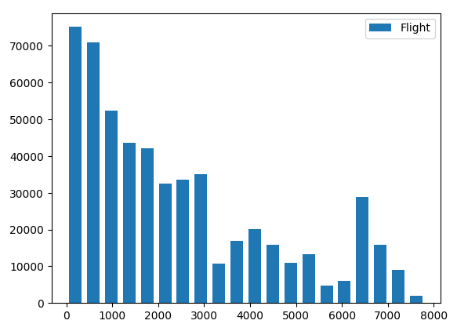
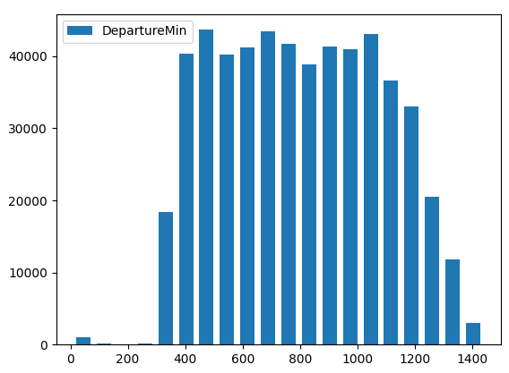
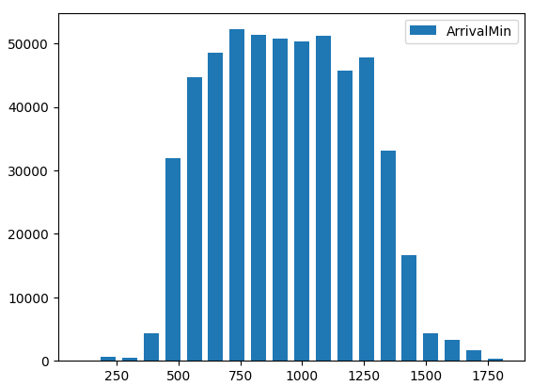
Analysis

Slide 8
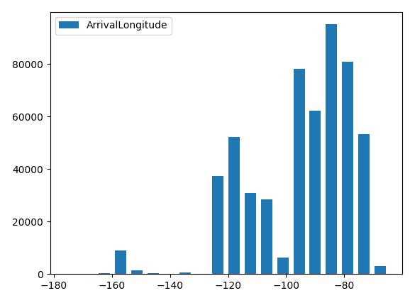
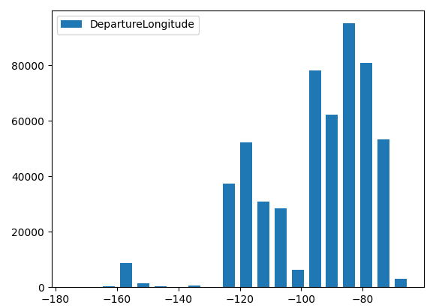
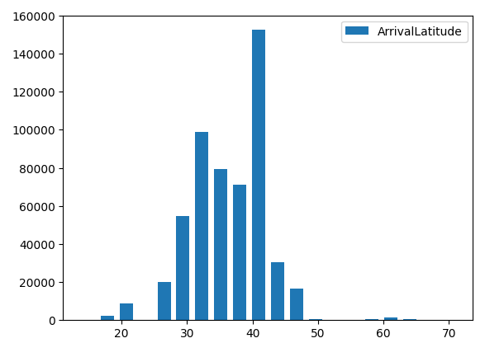
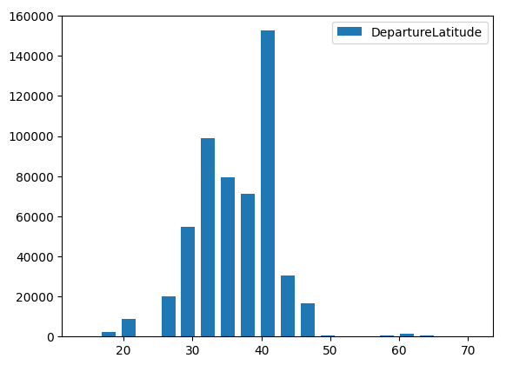
Analysis

Slide 9
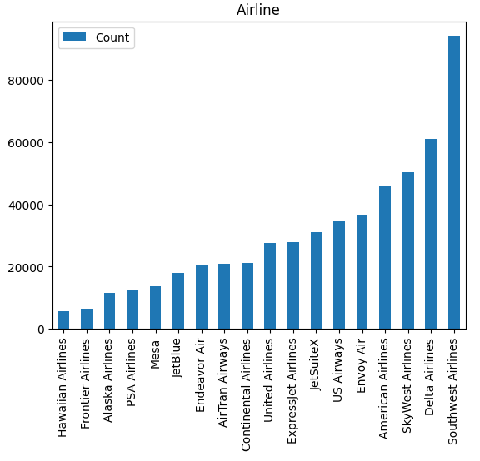
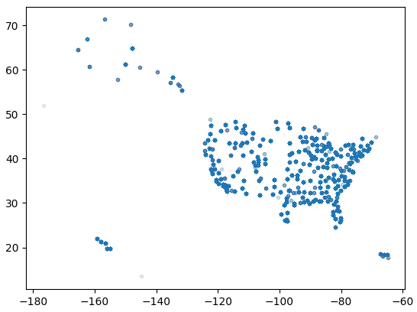
Analysis

Slide 10

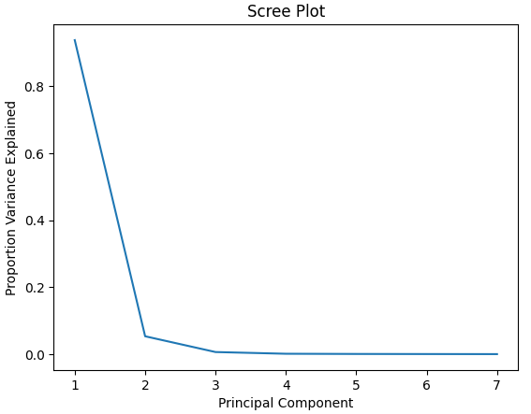
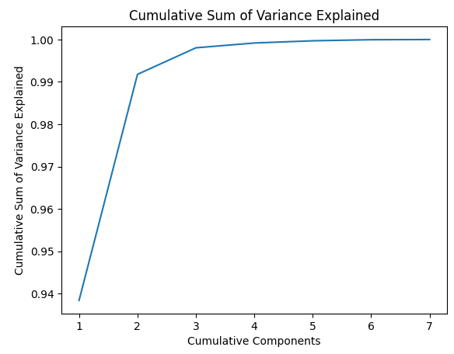
Principal Component Analysis

Slide 11
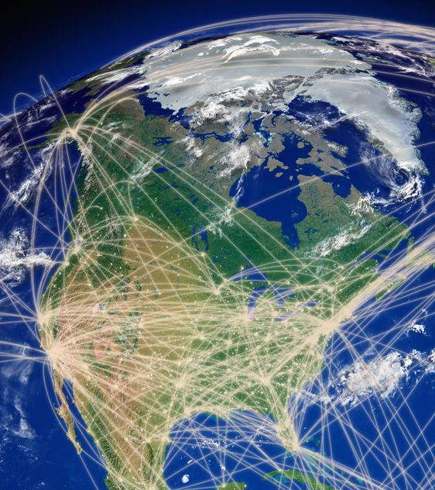
Correlations
'ArrivalLongitude' and 'DepartureLongitude'
0.637

Slide 12

Algorithms
Logistic Regression
Naive Bayes
Random Forest
Gradient Boosted Tree
Decision Tree
Support Vector Machine

Slide 13

Test Design
Cross Validation
3 Folds
Grid Parameter
Stages
StringIndexer
OneHotEncoder
VectorAssembler
StandardScaler
Modeling Algorithm
Data used 80/20 split

Slide 14

Results

Slide 15
Predictive Modeling
Model | AUC | Accuracy | Parameters
Logistic Regression | 61.1% | 63% | maxIter: 10
Naive Bayes | 60.1% | 60% | None
Random Forest | 62.0% | 64% | maxDepth: 30 subsamplingRate: 0.1
Gradient Boosted Tree | 62.1% | 64% | maxDepth: 5 maxIter: 25 stepSize: 0.2 subsamplingRate: 0.1
Decision Tree | 63.3% | 65% | maxDepth: 30
Support Vector Machine | 60.7% | 63% | maxIter: 2

